Slide 1

New GitHub User Access Process
August 15, 2023

Slide 2
SUMMARY
Starting Fall 2023, Sony Pictures’ ISG GitHub environment will be consolidated to the greater Sony Pictures GitHub enterprise account.
IMPACT
As a regular user/developer of Sony Pictures Entertainment (SPE) microsites, your current ISG GitHub account will be converted to a new account as part of this initiative. This new account will be tied to the Sony Pictures GitHub enterprise account as well as Sony Pictures’ OKTA environment.
There will be new processes tied to your new account for authentication, password resets, and even new username formatting. This guide will walk you through what the changes will look like and what to expect with your new account.

Slide 3
NEW ACCOUNTS
As previously stated your GitHub access will be converted into a new account. And this new account will be tied to an external Sony Pictures/OKTA account. So in order to get access to GitHub, you’ll need that Sony Pictures/OKTA account.
This Sony Pictures/OKTA account will be managed through Sony Pictures Identity Management system, known as “IDM”. And your username format will be First Initial + Last Name. For instance a user named Natasha Romanoff would be “NRomanoff.”
An IDM account will be created for you and linked to a Sony Pictures Okta account by the Sony Pictures team. So changing your IDM password will also change your OKTA password.
This is important because the Sony Pictures OKTA application will be the only way for you to access GitHub.
Your Sony Pictures/OKTA username will be important because your new GitHub account will be this user name + “_spe”. So in the above example’s case, her GitHub username would be “NRomanoff_spe”
The next slides will breakdown how all of this will work.

Slide 4
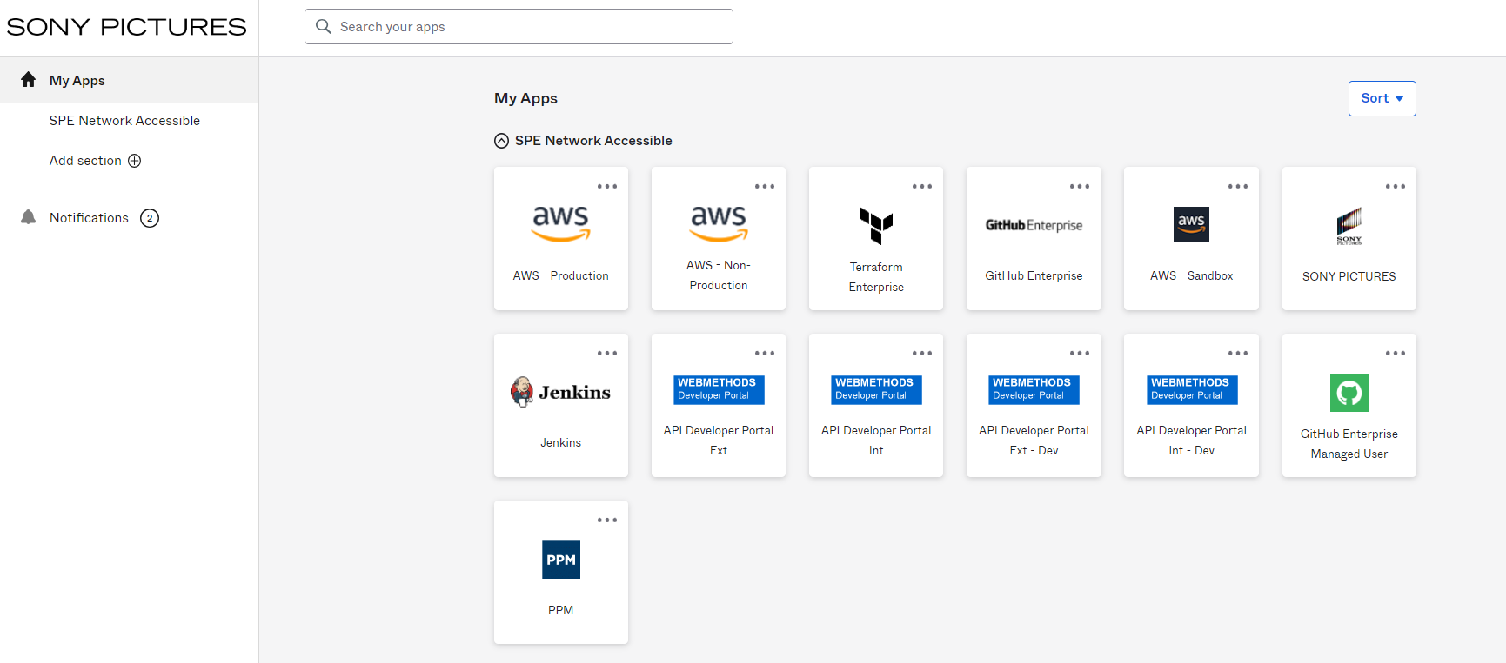
NEW ACCOUNTS
Step 1: Your IDM access will be set up by Sony Pictures IT. (You can continue to work with Sony Pictures ISG to help with any IDM account issues including password resets. More on this later.)
Step 2: Your IDM account will automatically be linked to Sony Pictures OKTA environment by Sony Pictures IT.
Step 3: ISG will verify with you that your IDM credentials are sent to you
Step 4: ISG will verify that you can access the Sony Pictures OKTA environment using your IDM credentials - https://spe.okta.com/
(pictured: The Sony Pictures OKTA environment)

Slide 5
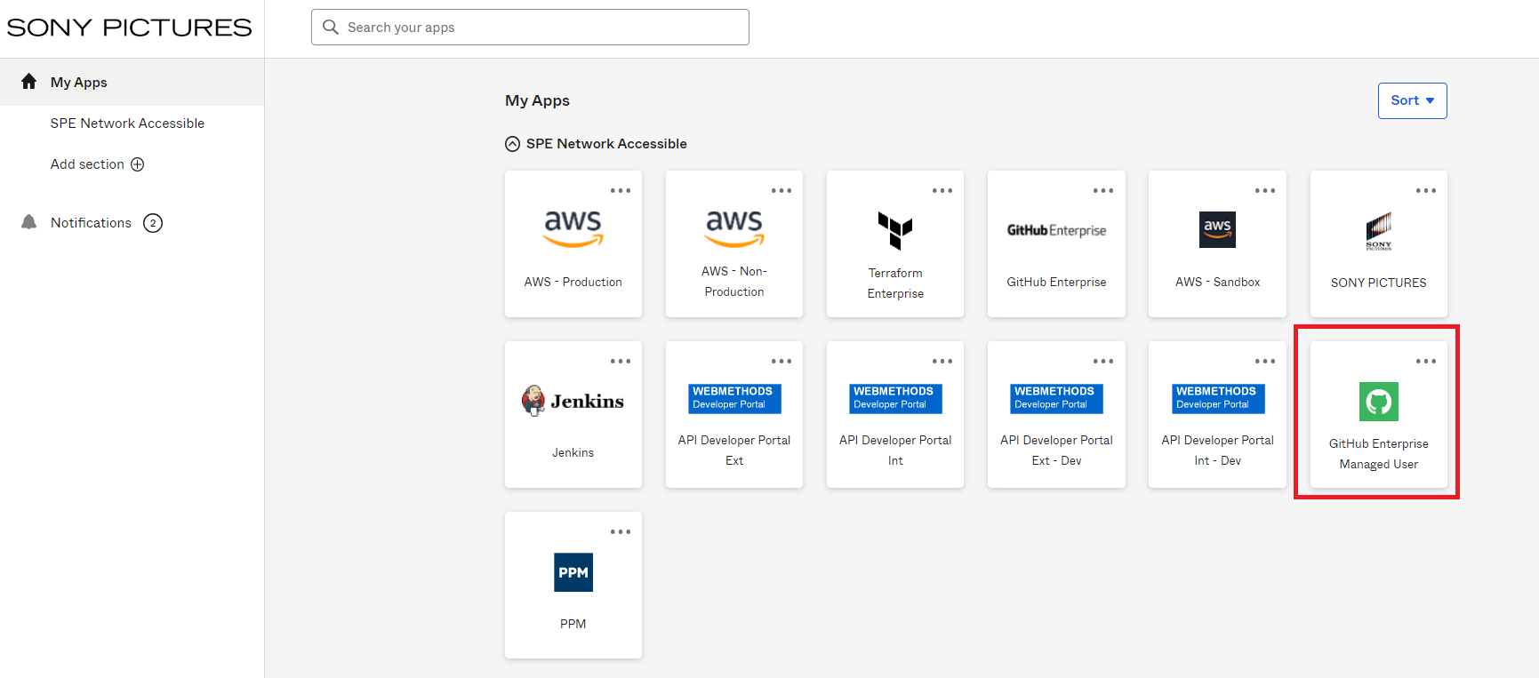
NEW ACCOUNTS
Step 5: Once you are able to access the OKTA environment, you’ll be able to access GitHub via the “My Apps” dashboard.
Step 6: You’ll want to select the “GitHub Enterprise Managed User” application

Slide 6
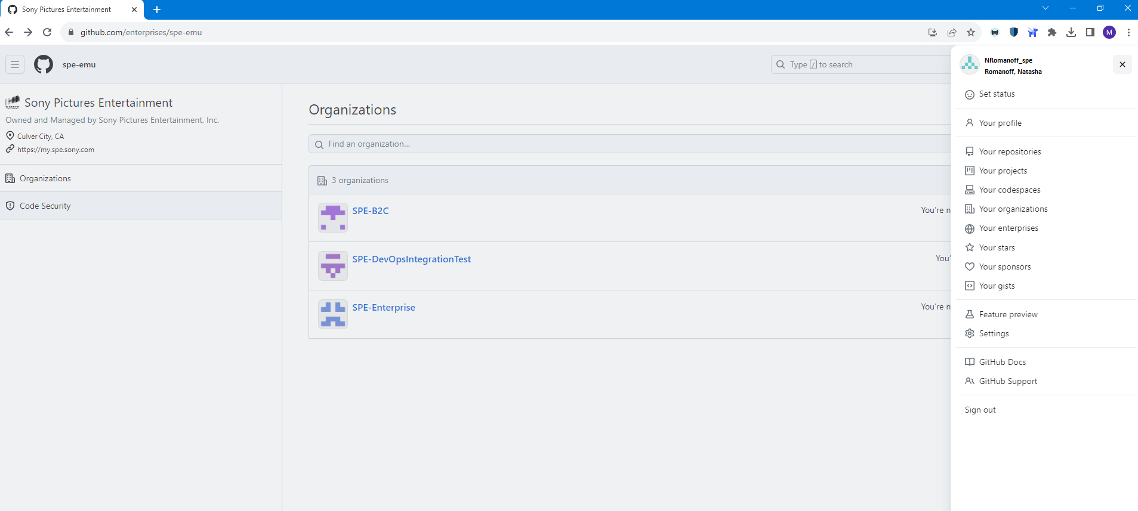
NEW ACCOUNTS
Step 7: You’ll access GitHub. The new organization for your repositories will be called “SPE-B2C.” Note that if you have a GitHub.com account already, this will be a separate SPE specific account that you’ll need to access your SPE projects.
Step 8: You’ll now be ready to clone repos, and push out projects as you see fit.

Slide 7
WHAT WON’T BE CHANGING
Basic git commands will stay the same
The GitHub CI/CD will stay the same
The GitHub branch structure will stay the same: - master = Local Machine (will deploy to stage environment) - production = Production Environment (a.k.a Live) - Users will continue to develop on master and push to production to launch their code
There will still be a 10 min cache for updating previously deployed content on Production
Repo Names will remain the same (Even though the organization will now be called “SPE-B2C”

Slide 8
ACCOUNT ASSISTANCE/PASSWORD RESET
Because your GitHub account will only be accessible via the Sony Pictures OKTA environment, you will need to work with ISG to have your passwords reset in IDM with Sony Pictures IT when they expire.
Passwords are set to expire every 90 days.
When logging into Okta, 3 incorrect password logins will lock a user’s account. And you’ll need to work with ISG to have Sony Pictures IT unlock your accounts or reset your password, or wait approximately 30 minutes to try again.
If new users need to be onboarded into GitHub, work with ISG to onboard them. Make sure you provide the new user’s full name, email address, mobile number, and static external IP

Slide 9
THANK YOU
August 15, 2023

